Slide 1

Introduction to Artificial Intelligence
Dr. Ravirajsinh S. Vaghela
Assistant Professor, NFSU

Slide 2
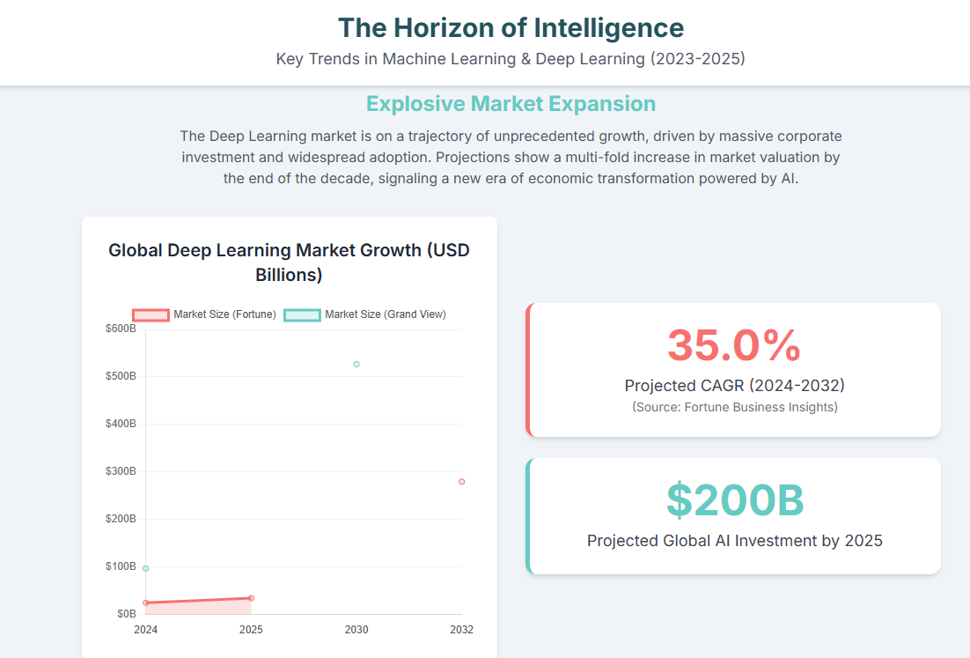

Slide 3
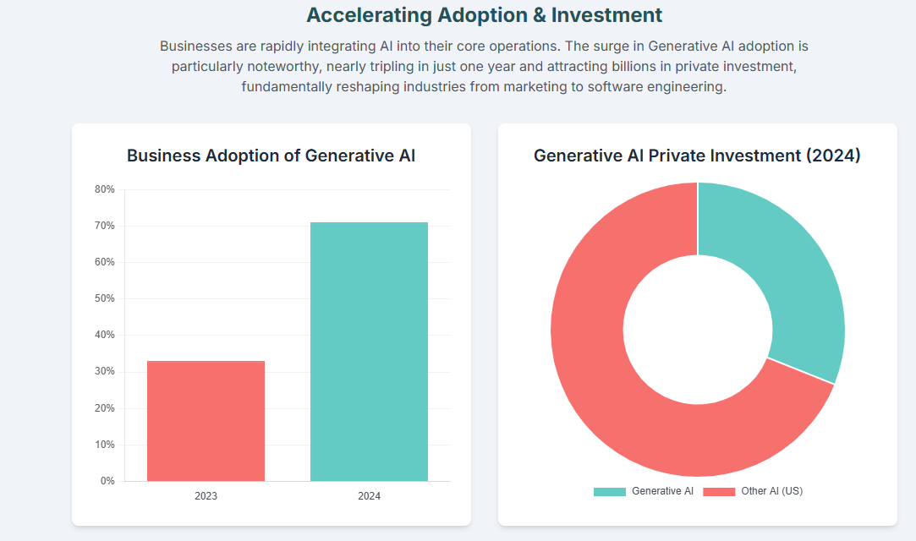

Slide 4
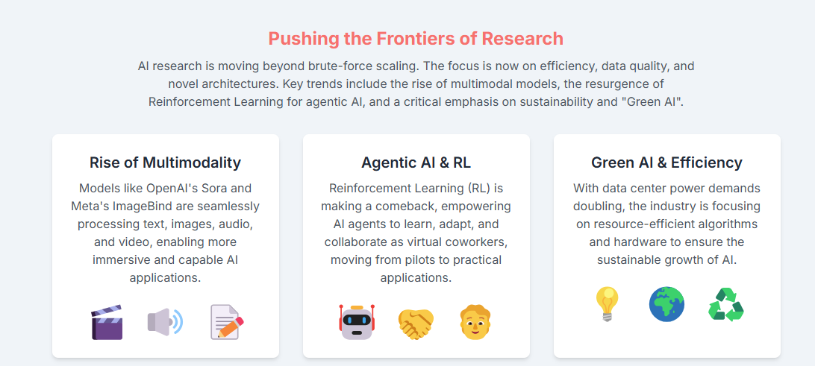

Slide 5
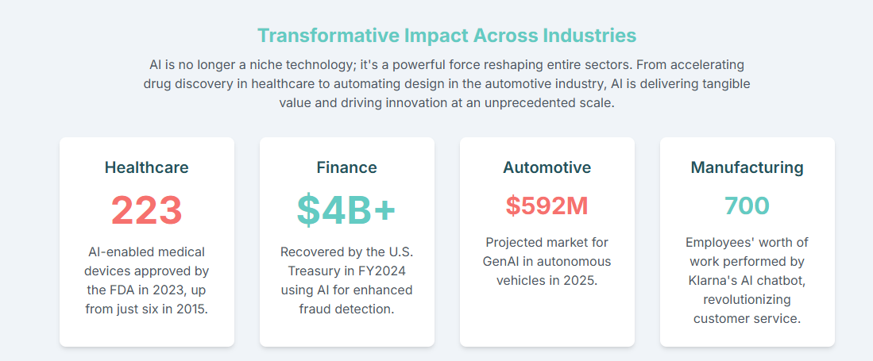

Slide 6
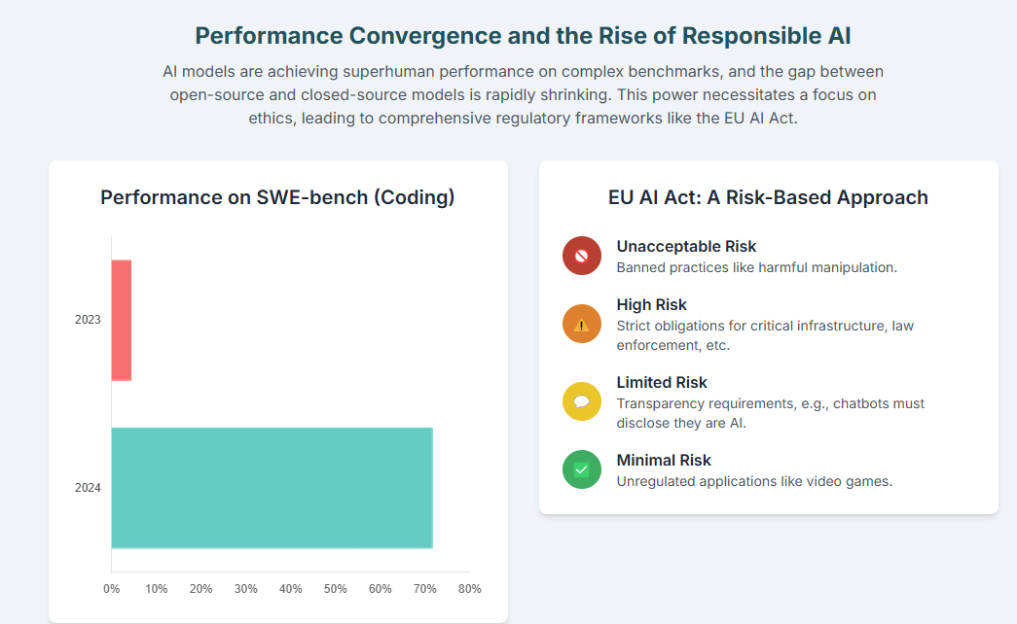

Slide 7
CTMDFIS SII P4 : Artificial Intelligence
Subject Details
Teaching Scheme
Theory Credits : 3
Practical Credits : 1
Evaluation Scheme
Internal Exams
TA1/ TA2 (25 Marks Each)
Mid Sem Exam : 50 Marks
End Sem Exam : 100 Marks
Practical End Sem Exam : 100 Marks
Unit – I Introduction to Maths for ML and Python
Unit – II Machine Learning
Unit – III Neural Network
Unit – IV Computer Vision and Natural Language Processing
Unit - V ML/DL for Cyber Security

Slide 8
Books for learning Math
https://mml-book.github.io/book/mml-book.pdf

Slide 9
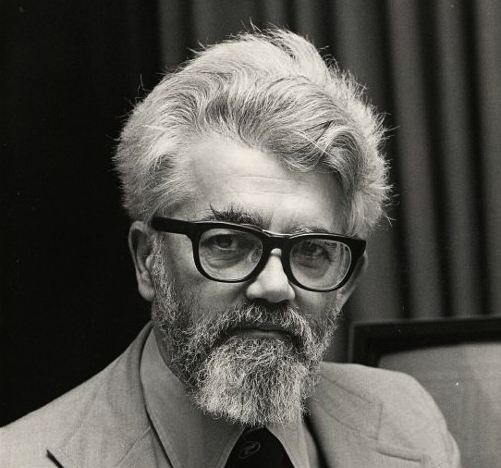
INTRODUCTION
AI is the science and engineering of making intelligent machines, especially intelligent computer programs (1956).
He also developed the LISP programming language
John McCarthy
(the father of Artificial Intelligence)
AI is a branch of computer science dealing with the simulation of intelligent behavior in computers.
AI is the study of how to make computers do things which, at the moment, people do better.
AI is, the study and design of intelligent agents where an intelligent agent is a system that perceives its environment and takes actions.

Slide 10

John Hopfield introduced memory-based Hopfield networks for pattern retrieval,
Geoffrey Hinton pioneered training methods like backpropagation and Boltzmann machines that advanced pattern recognition in neural networks.

Slide 11

What is AI?
“Artificial Intelligence is a technique that allows machines to act like humans by replicating their behavior and nature.”

Slide 12
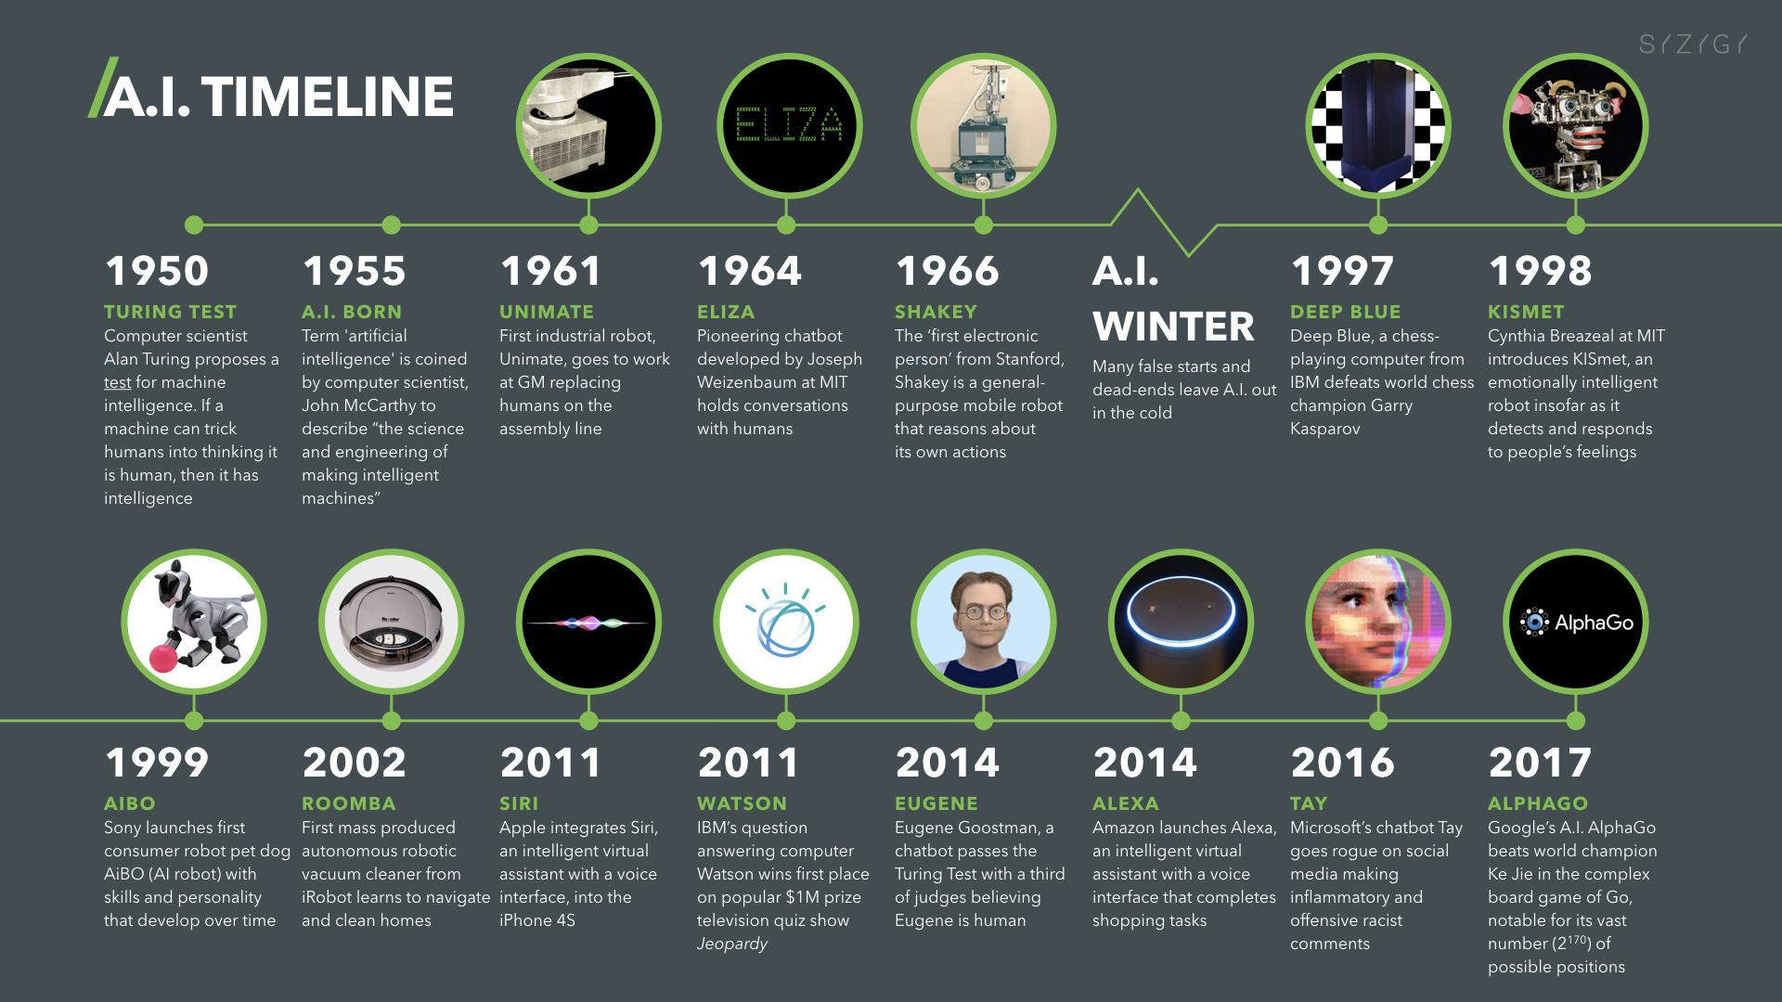
History of AI

Slide 13
Turing Test
Acting Humanly: The Turing Test proposed by Alan Turing (1950)
A Turing Test is a method of inquiry for determining whether or not a computer is capable of thinking like a human being.
The interrogator job is to try and figure out which one is human and which one is computer by asking questions to both of them.
The computer would try to remain indistinguishable from human as much as possible

Slide 14
Technique that enables machines to mimic human behavior
AI
Machine Learning
Subset of AI which uses statistical methods to enable machine to learn and improve with time
Data Science
Deep Learning
Subset of ML that includes algorithms and enables system to train itself

Slide 15
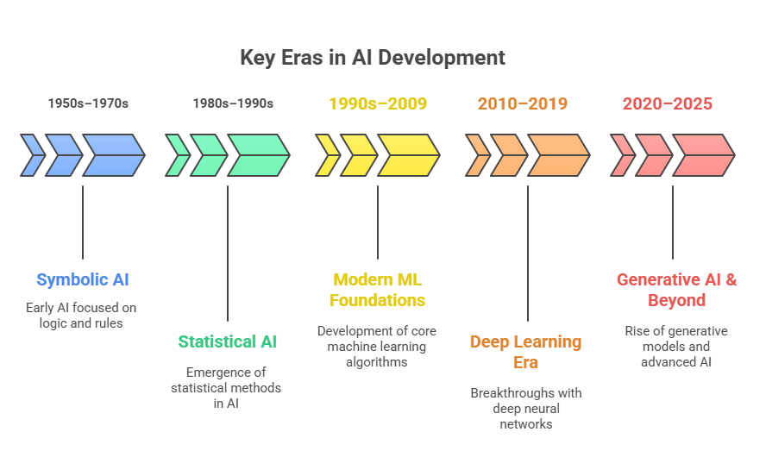

Slide 16
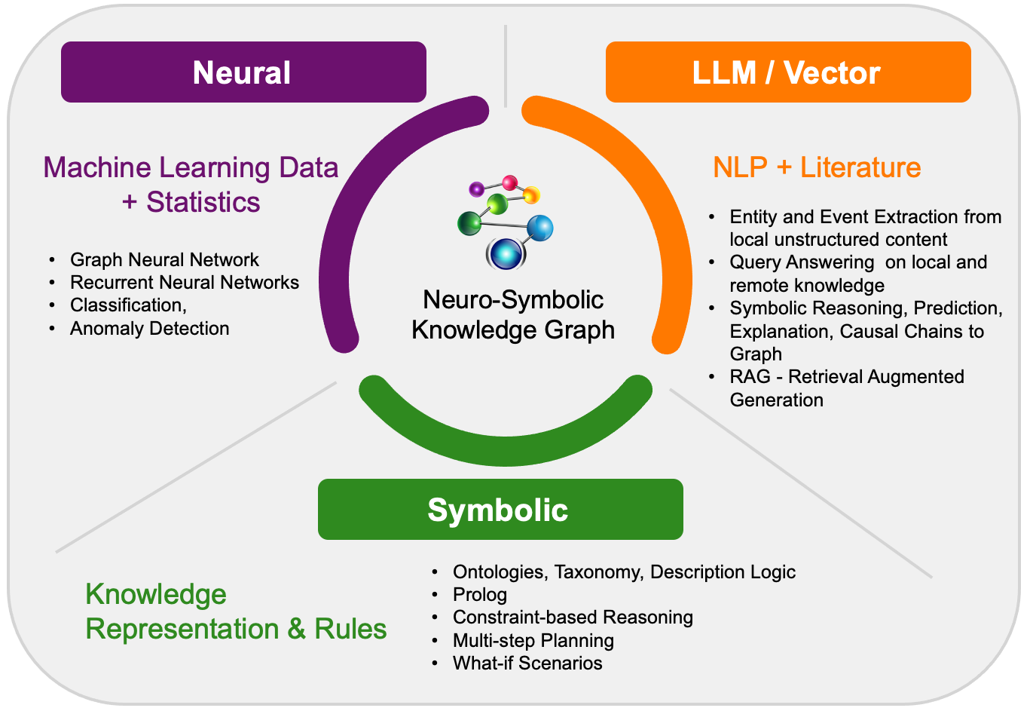
Traditional AI Algorithms

Slide 17
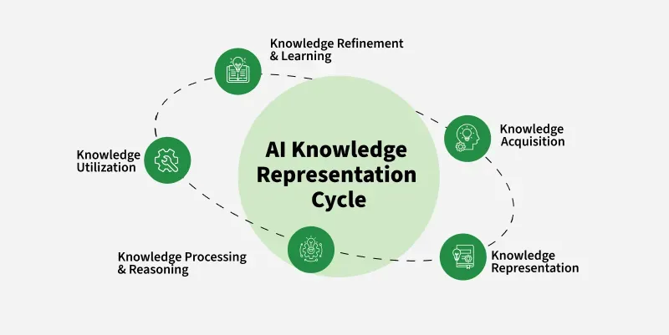
Traditional AI algorithm
1. Search Algorithms (1950s–1960s)
Examples: Depth-First Search (DFS), Breadth-First Search (BFS), A* Search
Why Important: Foundation of problem-solving in AI; introduced systematic ways to explore possibilities.
Applications: Route planning (Google Maps), puzzle solvers (chess, 8-puzzle).
2. Logic & Rule-Based Systems (1960s–1970s)
Examples: Propositional Logic, First-Order Logic, Production Rules, Expert Systems (like DENDRAL, MYCIN)
Why Important: Showed how knowledge representation + inference rules can mimic human experts.
Applications: Medical diagnosis (MYCIN), chemical structure prediction (DENDRAL), early chatbots.
3. Game-Playing AI (1960s–1990s)
Examples: Minimax Algorithm, Alpha-Beta Pruning
Why Important: Proved that machines can plan ahead strategically.
Applications: Chess engines (Deep Blue beating Kasparov in 1997), video game NPCs.

Slide 18
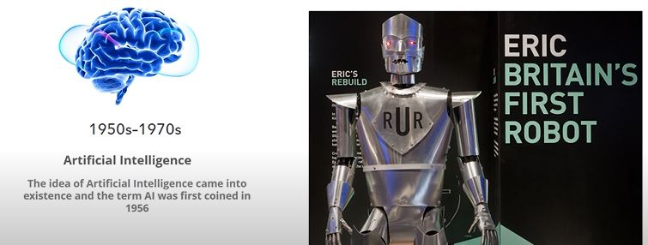
Why AI Winter?
The data we had was not enough to predict the accurate result.

Slide 19
Statistical AI
4. Optimization Algorithms (1960s–1980s)
Examples: Gradient Descent (for optimization), Simulated Annealing, Genetic Algorithms
Why Important: Introduced AI’s connection to mathematical optimization and evolution-inspired learning.
Applications: Scheduling, engineering design, portfolio optimization.
5. Early Statistical Learning (1960s–1990s)
Examples: Naïve Bayes Classifier, k-Nearest Neighbors (kNN), k-Means Clustering, Expectation-Maximization (EM)
Why Important: Brought probability/statistics into AI, shifting away from purely symbolic rules.
Applications: Spam filtering (Naïve Bayes), document retrieval, customer segmentation.
6. Decision Trees (1970s–1990s)
Examples: ID3 (1979), C4.5 (1993), CART
Why Important: Made ML interpretable and practical; easy to visualize decision logic.
Applications: Credit risk scoring, medical decision-making, business intelligence.

Slide 20
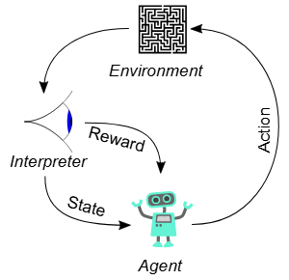
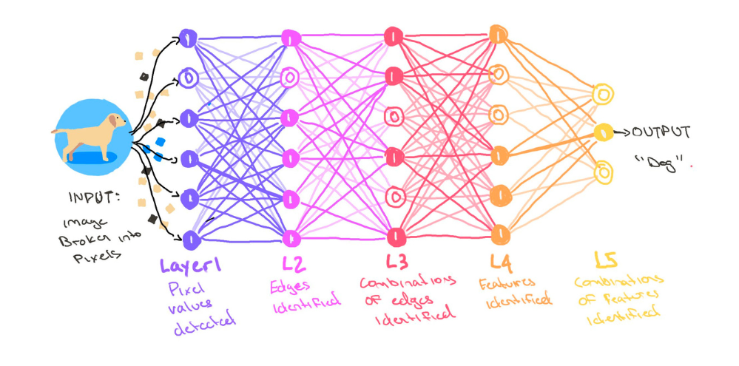
Statistical AI
7. Neural Networks (Early Waves: 1958–1990s)
Examples: Perceptron (1958), Multilayer Perceptrons, Backpropagation (1986), Hopfield Networks, Boltzmann Machines
Why Important: Early attempts at mimicking the brain; laid groundwork for deep learning much later.
Applications: Pattern recognition, character recognition, associative memory.
Reinforcement Learning (1980s–1990s)
Examples: Temporal Difference Learning (TD), Q-Learning (Watkins, 1989), TD-Gammon (Tesauro, 1992)
Why Important: Allowed machines to learn by trial and error.
Applications: Robotics, game playing (backgammon, later leading to AlphaGo).
Support Vector Machines (1995)
Why Important: A major ML breakthrough using geometry + optimization; worked well with small data and high-dimensional features.
Applications: Text classification (spam vs ham), handwriting recognition, bioinformatics.

Slide 21
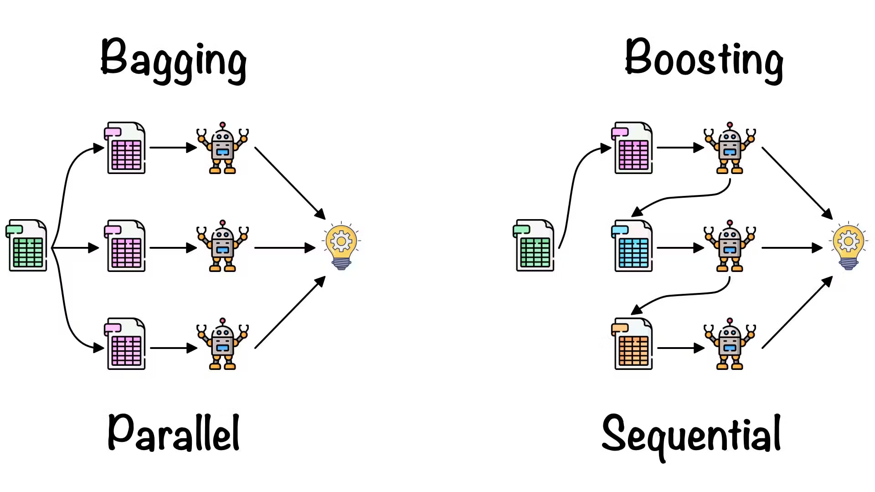
Statistical AI
10. Ensemble Methods (Late 1990s–2000s)
Examples: Bagging (1996), Boosting (AdaBoost, 1997), Random Forests (2001)
Why Important: Showed combining weak learners → strong model; improved accuracy in real-world tasks.
Applications: Fraud detection, medical diagnostics, financial modeling.
11. Probabilistic Graphical Models (1990s–2000s)
Examples: Bayesian Networks, Hidden Markov Models (HMMs), Markov Random Fields
Why Important: Unified probability + AI; enabled reasoning under uncertainty.
Applications: Speech recognition (HMMs in Siri/Google Voice), bioinformatics, computer vision

Slide 22
Why AI Winter?
Big Data - accumulated volume of big data was increased from 4.4 zettabytes to roughly 44 zettabytes or 44 trillion GBs of data
Advanced algorithms
High end computing power
Large storage

Slide 23
Application Domains of AI

Slide 24
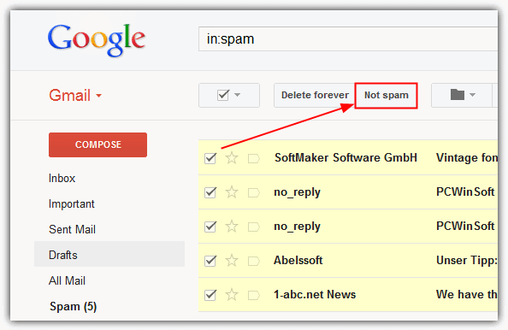
Machine Learning: Spam Filter in Gmail

Slide 25
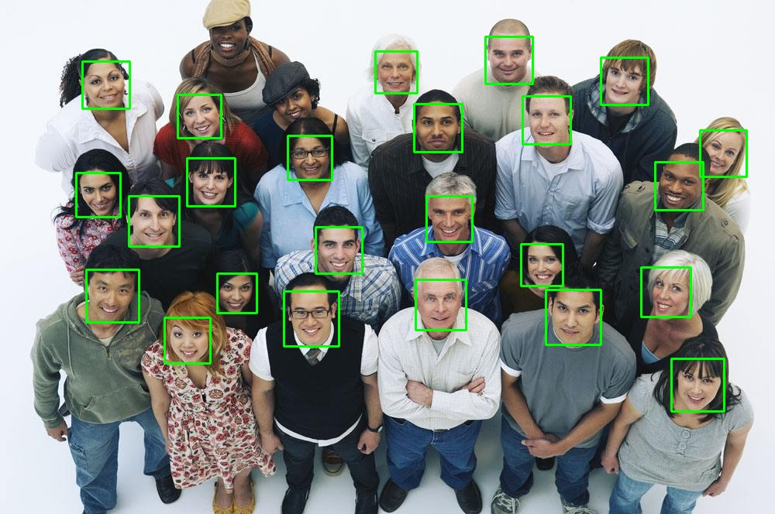
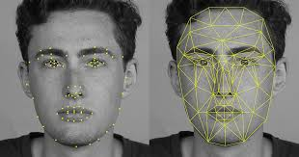
Computer Vision: Face Detection

Slide 26
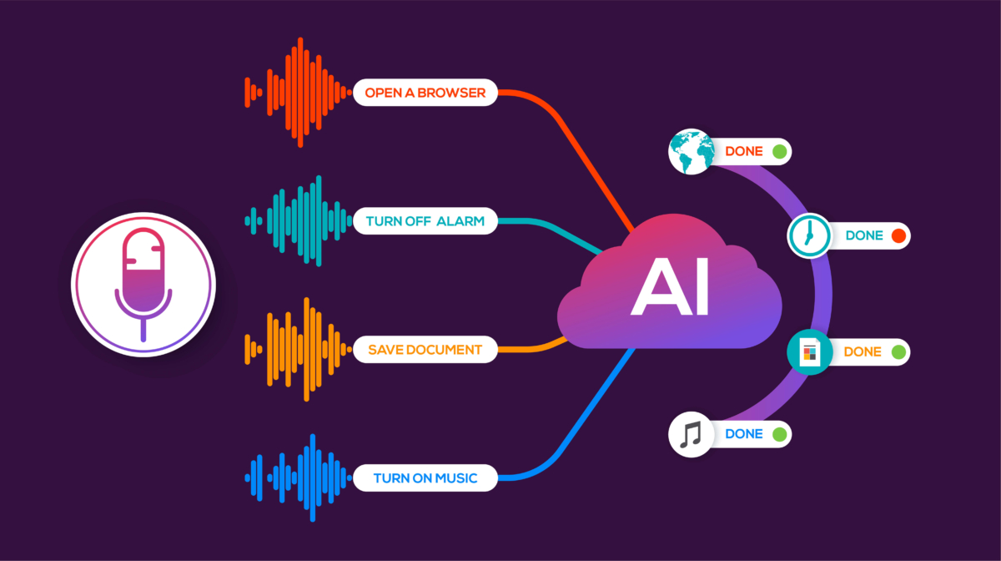
Speech Recognition: Voice Technology In Virtual Agents

Slide 27
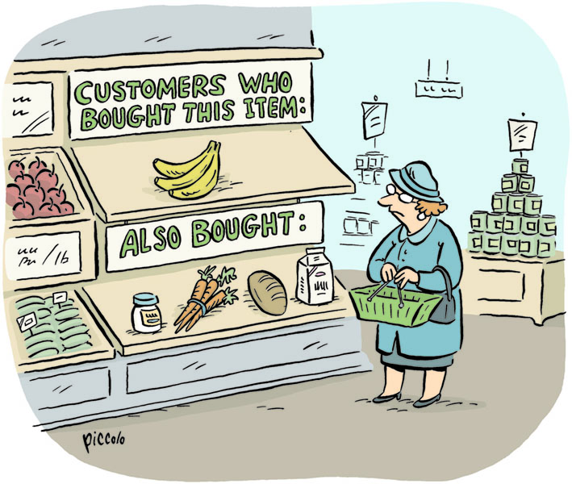
Data Mining: Market Basket Analysis

Slide 28

Expert Systems: Reinforcement Learning

Slide 29
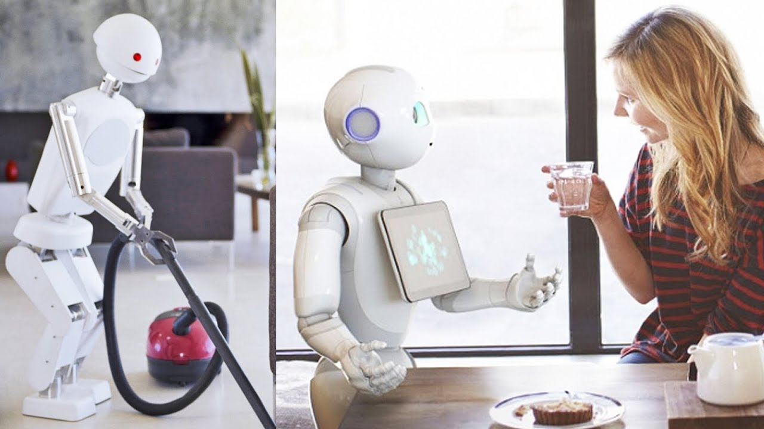
Robotics: Home Automation System

Slide 30

Optimization : Shortest Path

Slide 31
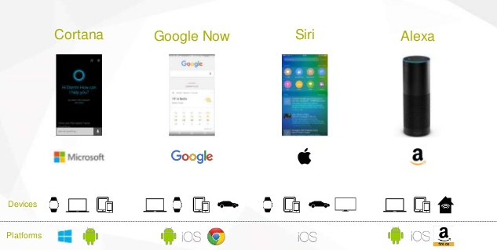
Virtual Agents : Chatbots

Slide 32

Supervised Learning : Online Shopping

Slide 33
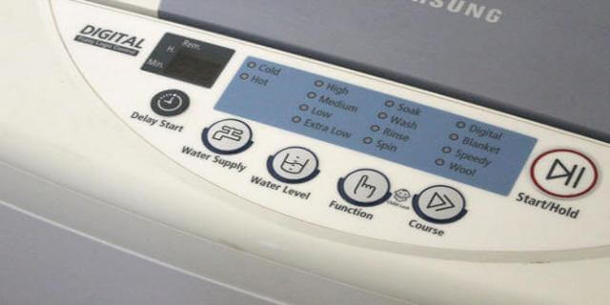
Fuzzy System : Automated Controlled Machine

Slide 34
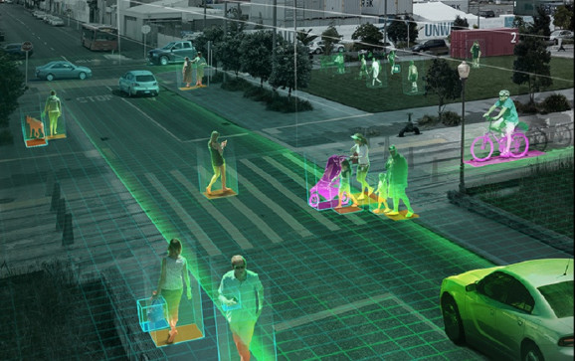
Security: NVIDIA Metropolis

Slide 35
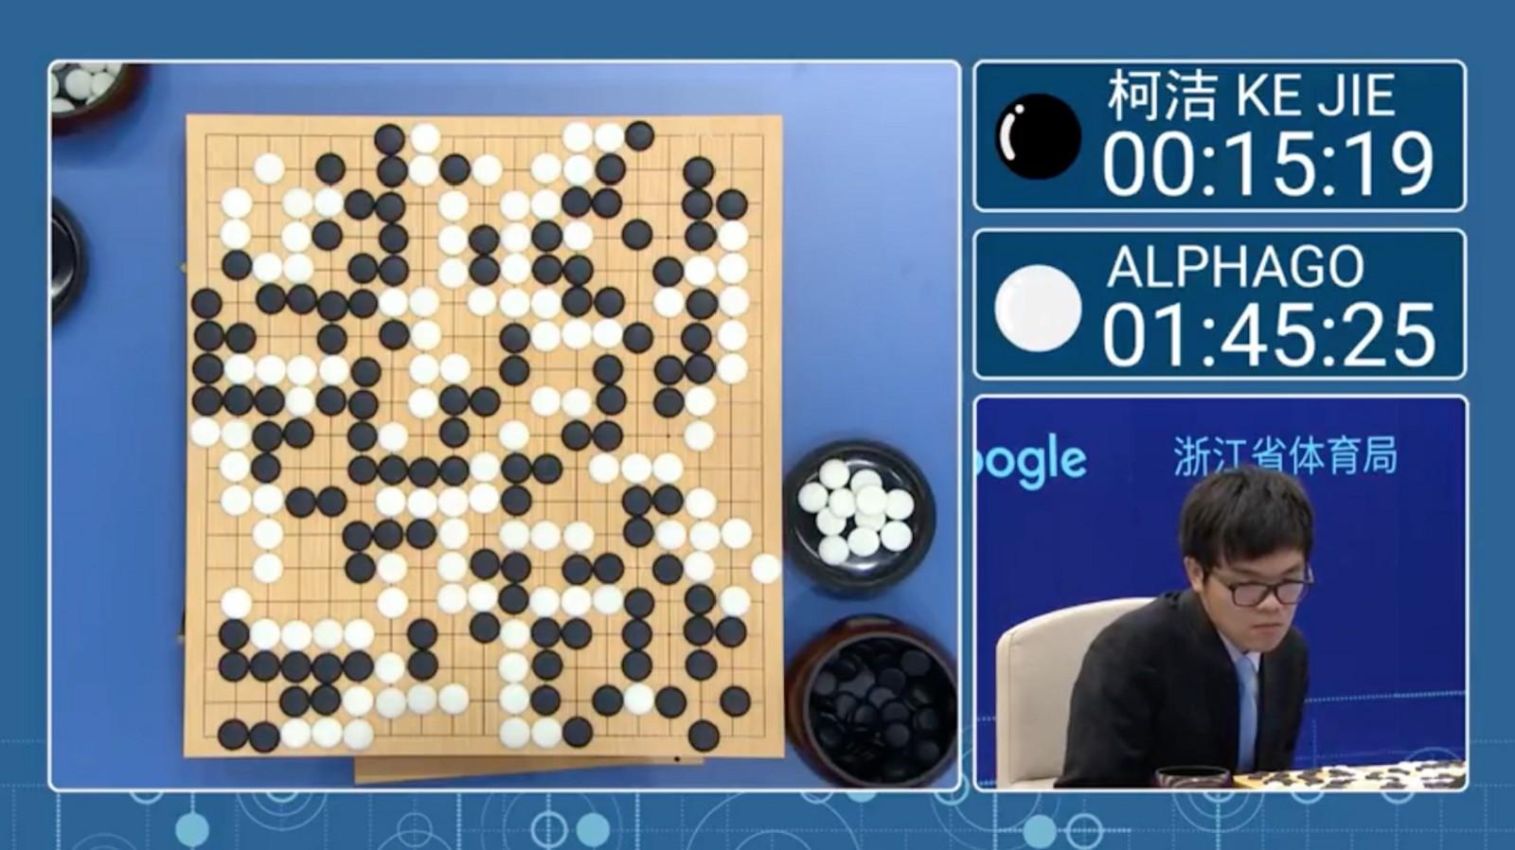
Game Playing

Slide 36
Virtual Agents : Chatbots

Slide 37
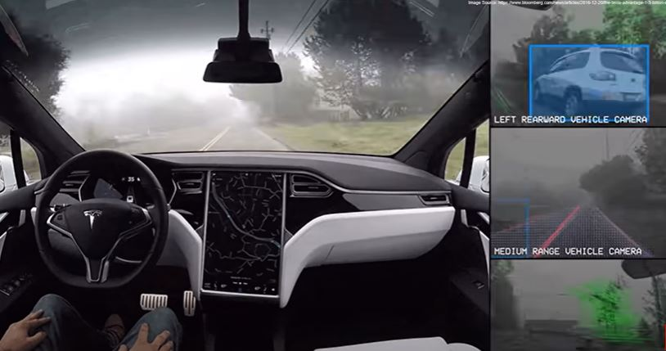
Tesla’s Self-Driving Car

Slide 38
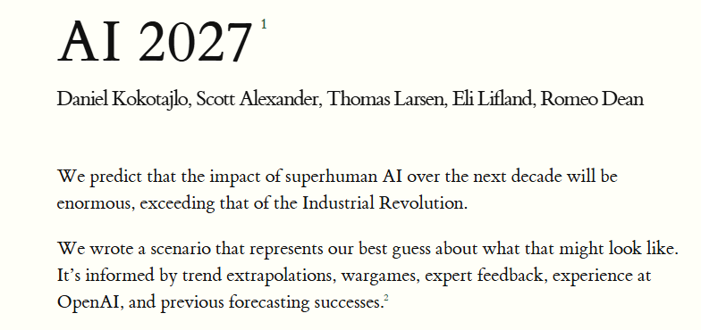
AI future projection
https://ai-2027.com/

Slide 39
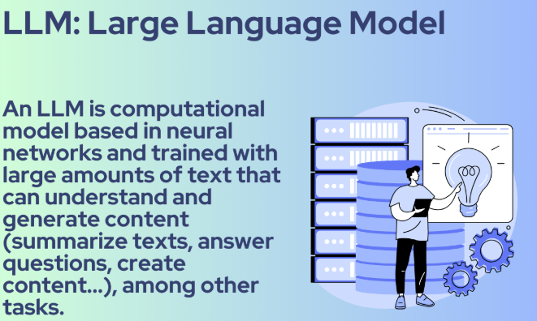
LLM Benchmarking Hub
https://epoch.ai/benchmarks
https://artificialanalysis.ai/models
https://www.vellum.ai/llm-leaderboard?utm_source=google&utm_medium=organic

Slide 40
What is Retrieval Augmented Generation (RAG) in AI
Retrieval Augmented Generation (RAG) is a technique that enhances the capabilities of large language models (LLMs) by integrating them with information retrieval systems.
Essentially, RAG empowers LLMs to access and utilize external knowledge sources to generate more accurate, up-to-date, and contextually relevant responses

Slide 41
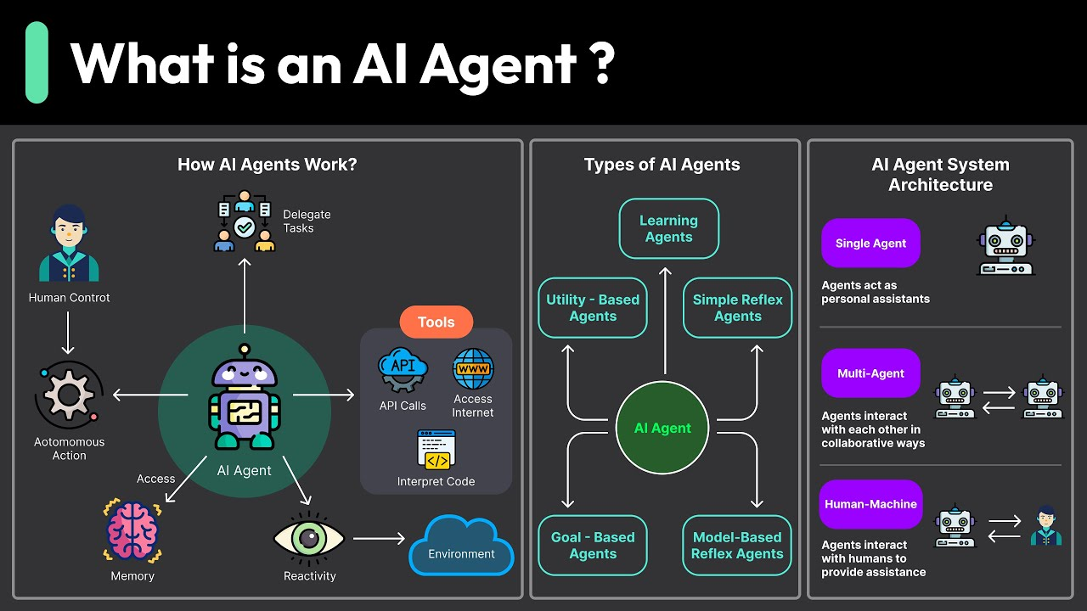

Slide 42
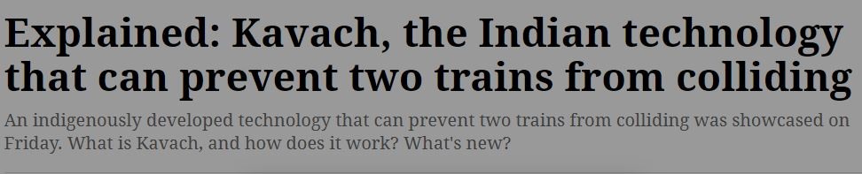
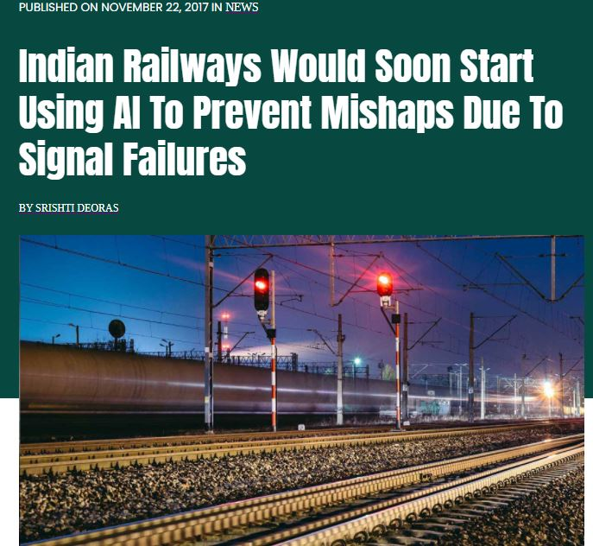

AI : In NEWS

Slide 43
Techniques of AI

Slide 44
Abstraction
Use of Knowledge
Search
Provides a way of separating important features and variations
Provides a way of solving complex problems by exploiting the structure of the objects
Provides a way of solving problems
Provides a framework

Slide 45
Why ML was Introduced?
How to efficiently train large complex models?
How to train more robust version of the AI systems?
How to design operational models of the brain?

Slide 46
What is ML?
Machine learning is a subset, an application of Artificial Intelligence (AI) that offers the ability to the system to learn and improve from experience without being programmed to that level.
Machine Learning uses data to train and find accurate results.
Machine learning focuses on the development of a computer program that accesses the data and uses it to learn from itself.
Example
Google uses it to filter spam, malware, and attempted phishing emails out of your inbox.
Your bank and credit card use it to generate warnings about suspicious transactions on your accounts.

Slide 47
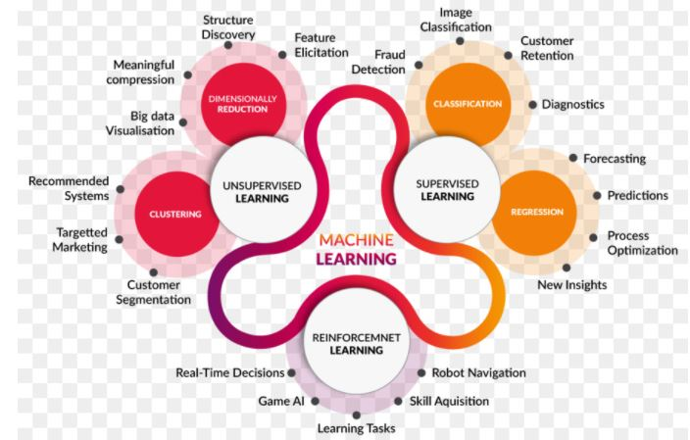
What is ML?

Slide 48
What is ML?
Supervised learning & semi-supervised learning
Supervised learning is a subset of machine learning that requires the most ongoing human participation — hence the name ‘supervised’. The computer is fed training data and a model explicitly designed to ‘teach’ it how to respond to the data.
Once the model is in place, more data can be fed into the computer to see how well it responds — and the programmer/data scientist can confirm accurate predictions, or can issue corrections for any incorrect responses.
In semi-supervised learning, the computer is fed a mixture of correctly labeled data and unlabeled data, and searches for patterns on its own. The labeled data serves as ‘guidance’ from the programmer, but they do not issue ongoing corrections.
Unsupervised learning
Unsupervised learning takes this a step further by using unlabeled data. The computer is given the freedom to find patterns and associations as it sees fit, often generating results that might have been unapparent to a human data analyst.
A common use for unsupervised learning is ‘clustering’, where the computer organizes the data into common themes and layers it identifies.

Slide 49
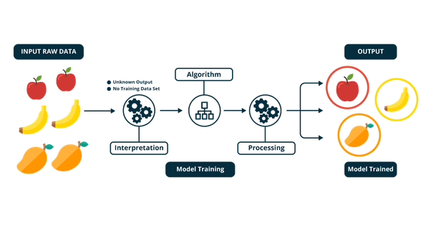
How ML works?

Slide 50
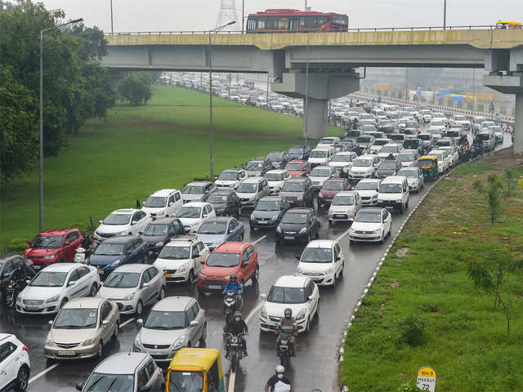
Example : ML Traffic Prediction

Slide 51
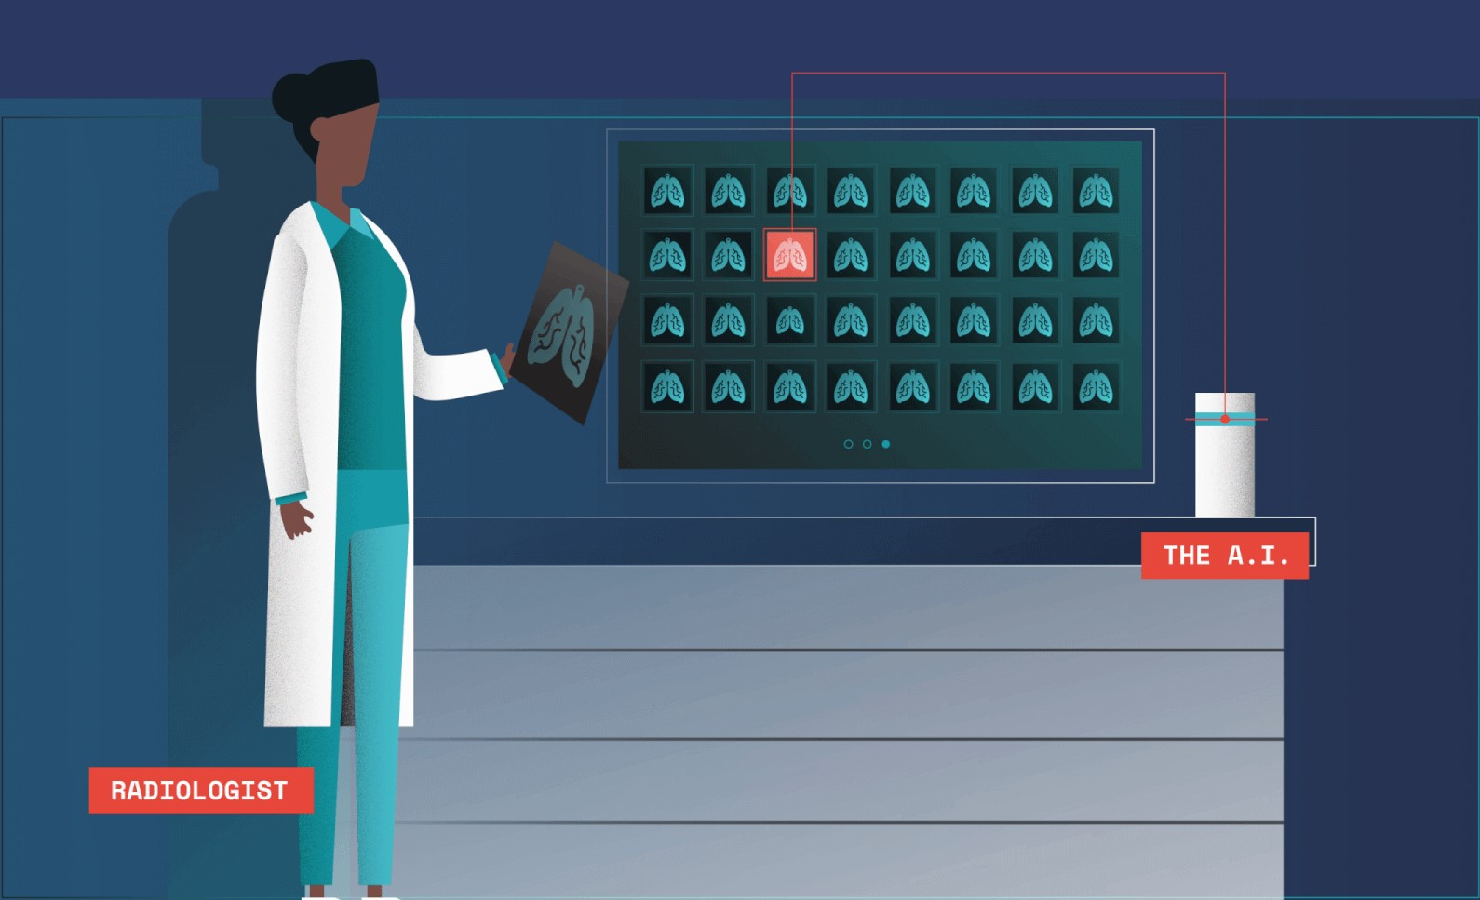
Example : ML Illness Prediction

Slide 52
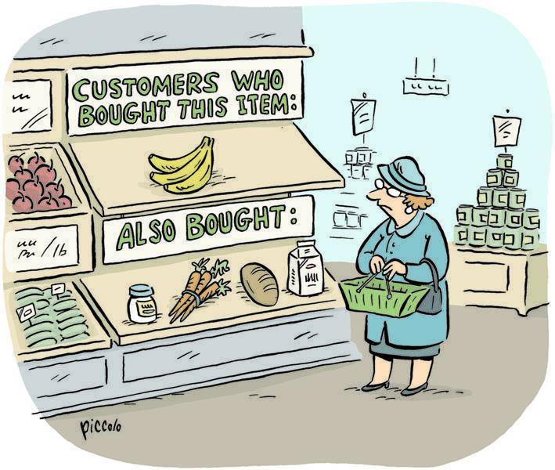
Example : ML Smart Cart : E - Commerce

Slide 53
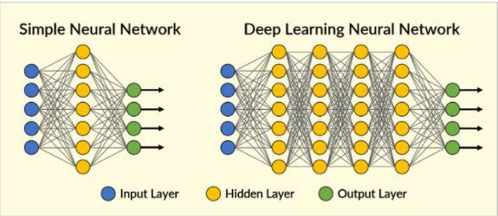
Deep Learning :DL
“DL is a particular kind of machine learning that is inspired by the functionality of our brain cells called neurons which led to the concept of artificial neural network”

Slide 54
Why Deep Learning?
Machine learning is about computers being able to perform tasks without being explicitly programmed… but the computers still think and act like machines.
Their ability to perform some complex tasks — gathering data from an image or video, for example — still falls far short of what humans are capable of.
Deep learning models introduce an extremely sophisticated approach to machine learning and are set to tackle these challenges because they've been specifically modeled after the human brain.
Complex, multi-layered “deep neural networks” are built to allow data to be passed between nodes (like neurons) in highly connected ways. The result is a non-linear transformation of the data that is increasingly abstract.

Slide 55
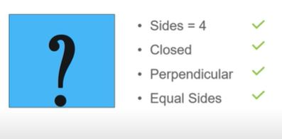
Example : DL Pattern Recognition

Slide 56
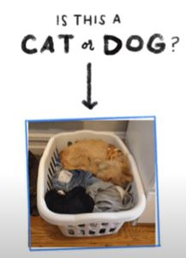
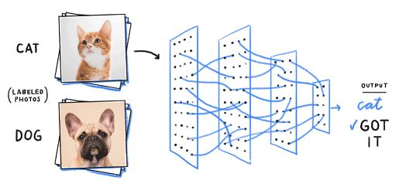
Example : DL Object Recognition

Slide 57
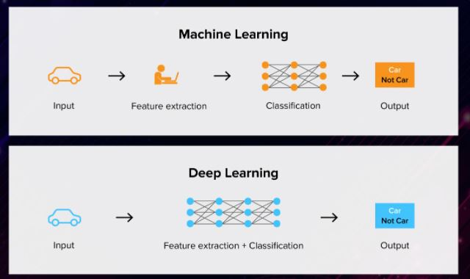
Ml vs DL Deep Learning IS Machine Learning

Slide 58
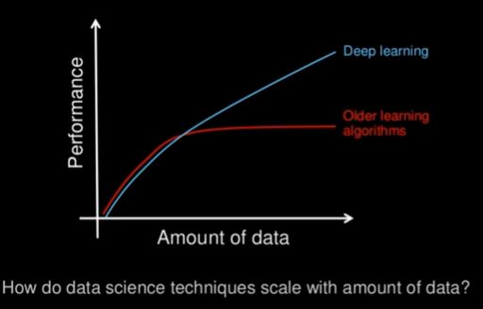
Ml vs DL Data Dependency

Slide 59

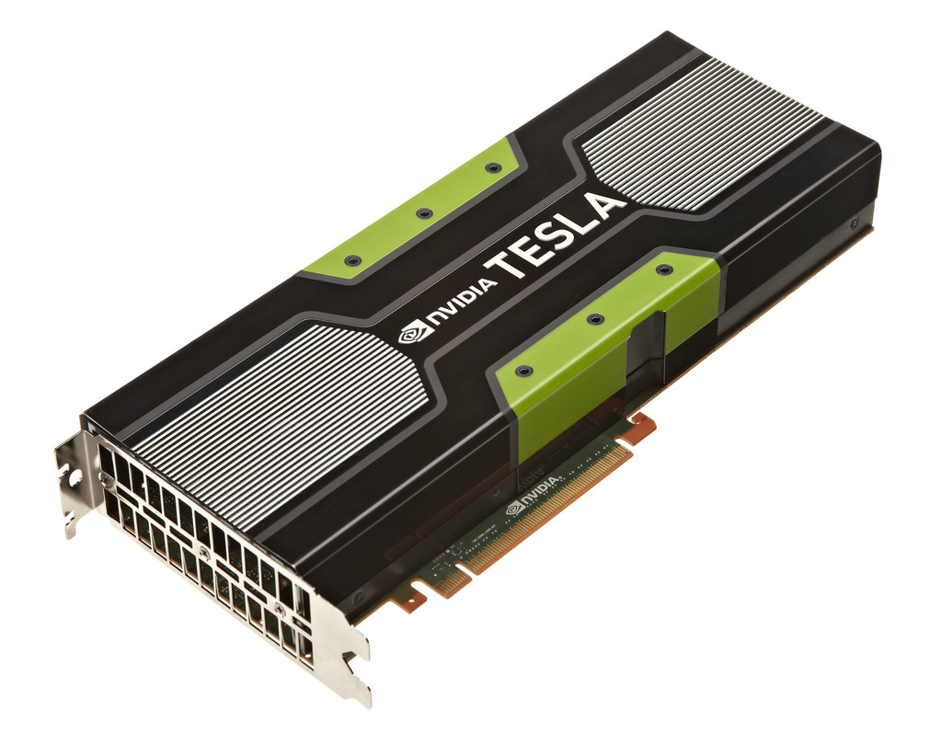
Ml vs DL Hardware Dependency
URL : https://www.databasemart.com/blog/best-gpus-for-ai-and-deep-learning-2025?srsltid=AfmBOor_xbUjRBCYaMsHJ65mey5jmTqY3ylLh2v7Xvbao8_c2b7ZR6nr

Slide 60
What is VRAM in GPUs?
VRAM = GPU memory.
It stores model parameters, activations (intermediate results), gradients, and the input batch during training.
If VRAM runs out → training crashes with an Out of Memory (OOM) error.

Slide 61
What is Floating Point?
A way to represent real numbers in computers (like decimals, fractions).
Defined by bit width → more bits = higher precision & range.
Precision | Bits | Value Range | Typical Use
FP32 (Single precision) | 32 | ~3.4 × 10^38 | Standard training, older GPUs
FP16 (Half precision) | 16 | ~6.5 × 10^4 | Faster training, saves VRAM
BF16 (bfloat16) | 16 | ~3.4 × 10^38 | Keeps FP32 range, less precision
FP8 | 8 | ~2 × 10^2 | New (H100 GPUs), huge speed/memory savings

Slide 62

Imagine a restaurant kitchen:
CPU = 8 expert chefs → very skilled but only 8 people cooking.
GPU with CUDA cores = 10,000 junior cooks → each does a small task, but together finish a giant order very fast.
Deep learning prefers the many-cooks model → because multiplying huge matrices can be split into thousands of small jobs.

Slide 63
What is CUDA?
CUDA = Compute Unified Device Architecture.
It’s NVIDIA’s parallel computing platform and API that allows developers to use the GPU for general-purpose computing (not just graphics).
With CUDA, you can write programs in C, C++, Python (via PyTorch, TensorFlow, etc.) that run directly on the GPU.
Without CUDA, your code would run only on the CPU (much slower for deep learning).

Slide 64
What are CUDA Cores
CUDA Cores are the basic processing units inside an NVIDIA GPU.
Each CUDA Core can perform simple math operations (like add, multiply).
Thousands of CUDA cores work in parallel to process large amounts of data.
Think of CPU cores as a few strong workers (8–32 cores), while GPU CUDA cores are like thousands of small workers (up to 18,000+ cores in modern GPUs).
More Reading : https://aerospike.com/blog/cpu-vs-gpu/

Slide 65
CUDA Cores vs 🟣 Tensor Cores
CUDA Cores (General GPU Cores)
What they are:
The basic execution units in an NVIDIA GPU.
Handle general-purpose parallel computation (matrix multiplications, vector ops, rendering).
Role in Deep Learning:
Execute all standard math operations: additions, multiplications, matrix ops.
Can run FP32 (single precision), FP64 (double precision), FP16 (half precision).
Analogy:
Like thousands of workers who can do any kind of math but not ultra-specialized.
Tensor Cores (Specialized AI Cores)
What they are:
Special hardware units introduced in NVIDIA Volta (V100, 2017) and present in Turing, Ampere, Ada Lovelace, Hopper GPUs.
Optimized for tensor operations (the backbone of deep learning).
Role in Deep Learning:
Accelerate matrix-multiply-and-accumulate (MMA) operations.
Extremely fast for FP16, BF16, TF32, INT8 — precisions commonly used in DL training & inference.
Example: multiplying a 4×4 matrix block in one cycle (instead of many cycles on CUDA cores).
Analogy:
Like specialized robots trained only to do matrix multiplication super-fast, freeing CUDA cores for other work.

Slide 66
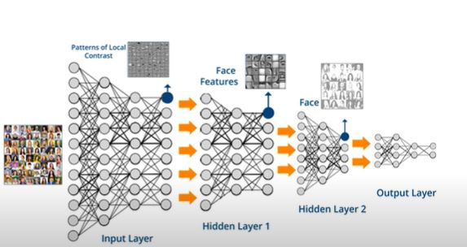
Ml vs DL Problem Solving Approach

Slide 67
Ml vs DL Execution Time?
Factor | Machine Learning | Deep Learning
Training Time | Short (sec–min) | Long (hours–weeks)
Inference Time | Very fast | Moderate (depends on GPU)
Hardware Needs | CPU | GPU/TPU (VRAM heavy)
Data Requirement | Small/Medium | Huge datasets
Best For | Tabular data, fast tasks | Images, NLP, speech, large AI models

Slide 68
Ml vs DL
Ml uses algorithms to parse data, learn from that data, and make informed decisions based on what it has learned
DL structures algorithms in layers to create an artificial “neural network” that can learn and make intelligent decisions on its own

Slide 69
Ml vs DL
Human Intervention
Machine learning requires more ongoing human intervention to get results. Deep learning is more complex to set up but requires minimal intervention thereafter.
Hardware
Machine learning programs tend to be less complex than deep learning algorithms and can often run on conventional computers, but deep learning systems require far more powerful hardware and resources. This demand for power has driven has meant increased use of graphical processing units.

Slide 70
Ml vs DL
Time
Machine learning systems can be set up and operate quickly but may be limited in the power of their results. Deep learning systems take more time to set up but can generate results instantaneously
Approach
Machine learning tends to require structured data and uses traditional algorithms like linear regression. Deep learning employs neural networks and is built to accommodate large volumes of unstructured data.
Applications
Machine learning is already in use in your email inbox, bank, and doctor’s office. Deep learning technology enables more complex and autonomous programs, like self-driving cars or robots that perform advanced surgery.

Slide 71
Python for Machine Learning

Slide 72
Unit I : Python
Basic Commands and Functions of Python
Python Scripting
numPy
It is a library for the Python programming language, adding support for large, multi-dimensional arrays and matrices, along with a large collection of high-level mathematical functions to operate on these arrays.
Pandas
It is a software library written for the Python programming language for data manipulation and analysis. In particular, it offers data structures and operations for manipulating numerical tables and time series.
Matplotlib
Matplotlib is a plotting library for the Python programming language and its numerical mathematics extension NumPy. It provides an object-oriented API for embedding plots into applications

Slide 73
What is Python?
Most popular language in the world!
Easier to understand and code in than C or C++.
It is an interpreted language. Program executes line-by-line. No compilation.
It is a type less language. No need to declare variables like int x in C.
It is an indented language. Indentation is compulsory, otherwise your program will not run!
Contains libraries and support for almost everything.
It is called a scripted language. Runs one thing at a time.
It is an object oriented language.
Shall learn more about this later.
It’s something like Java.
No pointers in Python. All data allocated dynamically.

Slide 74
Setting up The Environment
Assignments shall be given throughout the lab course. Practise coding well.
You can either use Google Colab : https://colab.research.google.com/
OR
Install Python3 in your system.
First, go to python website: www.python.org
Click on ‘Downloads’ in the website and download Python3
OR
Install Anaconda -Jupyter

Slide 75
What are Environment Variables?
Environment variables (sometimes called "env vars") are variables you store outside your program that can affect how it runs. For example, you can set environment variables that contain the key and secret for an API. Your program might then use those variables when it connects to the API.
Storing your secrets in your environment instead of your source code has a few advantages:
Security: Environment variables help you safeguard sensitive data like API keys and passwords. For example, you may not want whoever downloads your source code access to an API key you are using.
Configuration Management: With environment variables, it’s easy to store and manage configuration settings.
Portability: You can adapt applications to different environments without code changes. For example, if your code behaves differently on different operating systems, you can use an environment variable to manage this.
Testing and Debugging: Developers can simplify testing and debugging by adjusting environment variables rather than changing the code.

Slide 76
How to Use Environment Variables in Python
import os
os.environ
https://www.simplilearn.com/tutorials/python-tutorial/python-path

Slide 77
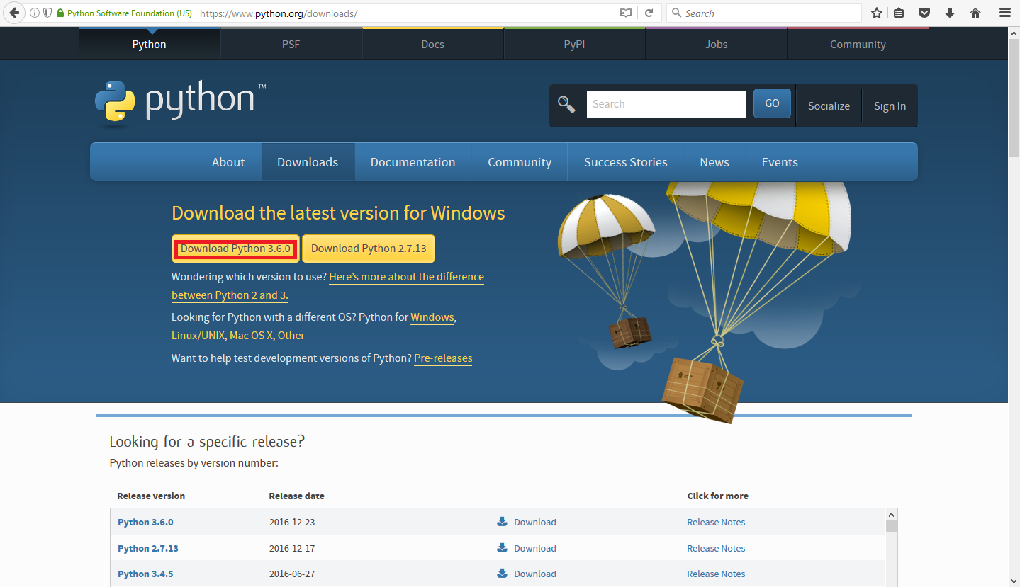
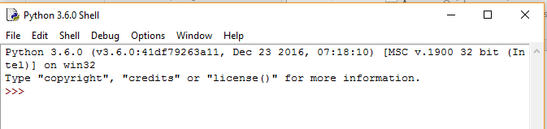
Installing Python3 on your Windows System
After the download, run the exe file.
Once done, launch the program IDLE Python from Start Menu.
Start coding like you would do here in the lab!

Slide 78
Python Scripting
In Python scripts, we write exactly the statements that we would have written in the interpreter.
We write Python scripts using vi as before.
vi test.py
We run a Python script using the following command in terminal:
python test.py

Slide 79
Operators
unary, binary or ternary
Arithmetic Operators
Relational Operators
Assignment Operators
Bitwise Operators
Logical Operators

Slide 80
Operator Precedence
The Higher the Position, the Higher the Precedence
**
~ + (unary) – (unary)
* / % //
+ -
&
^ |
<= >= < >
<> == !=
= %= /= //= -= += *= **=
not and or

Slide 81
Array vs. List in Python
List: A list in Python is a collection of items which can contain elements of multiple data types, which may be either numeric, character logical values, etc.
sample_list = [1,"Yash",['a','e']]
print(sample_list)
Array: An array is a vector containing homogeneous elements i.e. belonging to the same data type. Elements are allocated with contiguous memory locations allowing easy modification, that is, addition, deletion, accessing of elements.
import array
sample_array = array.array(‘K', [1, 2, 3])
# accessing elements of array
for i in sample_array:
print(i)

Slide 82
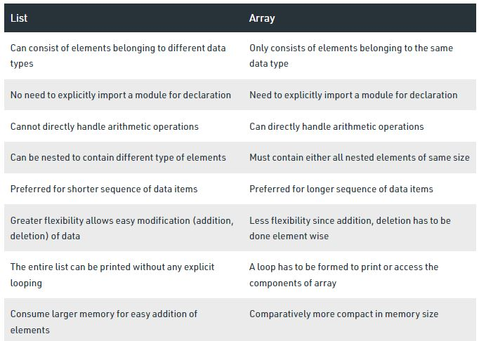
Array vs. List in Python

Slide 83
Array or List in Python
Initializing a list,
>>> a = []
>>> b = [1,2,3]
>>> c = [1,2.5,”a”,”cap”]
Printing
>>> print (b) will print [1,2,3]
Adding or Removing a single item,
>>> a = []
>>> a.append(2) # will add 2 to the list a
>>> a = [2,5,6,3,2]
>>> a.remove(2) # will remove the 1st 2

Slide 84
Array or List in Python
Adding a list of items to another list,
>>> a = [1,2,3]
>>> b = [10,11]
>>> a.extend(b)
>>> print (a) # will output [1,2,3,10,11]

Slide 85
Array or List in Python
Some common operations on lists,
>>> a = [5,2,3,6,1]
>>> len(a) # will return length of array
>>> a.sort() # will sort the array a
>>> a.reverse() # will reverse the array a
>>> a.count(x) # will return how many times x appears in a
>>> sum(a) # will return the sum of a

Slide 86
Strings
Strings are just (arrays of characters )
Example:
>>> s = “Rourkela”
>>> print (s[2]) # will print “u”
>>> print (len(s)) # will print 8
>>> s.append(‘A’) # will show error
>>> s = s + “A”
>>> print (s) # will print RourkelaA

Slide 87
Strings
Slicing is same as in lists
>>> s = “Rourkela”
>>> print (s[0:5]) # will print “Rourk”
>>> print (s[::-1]) # will print “alekruoR”

Slide 88
Strings
Removing a single character from a string
>>> s = “rourkela”
>>> print (s.index(‘u’)) # will print 2
>>> i = s.index(‘u’)
>>> s.replace(s[i], ‘’)
>>> print (s) #
will print “rorkela”

Slide 89
Strings
Removing multiple occurrence of the same character from a string
>>> s = “rourkela”
>>> s.replace(‘r’, ‘’)
>>> print (s) # will print “oukela”

Slide 90
2D lists (multidimensional arrays)
Lists inside lists
>>> A = [ [1,2,3], [4,5,6], [7,8,9]]
>>> print (A[1][2]) # will print 6
>>> print (A[-1][-1]) # will print 9
>>> B = [“cat”, “dog”, “ball”]
>>> print (B[2][1]) # will print ‘a’

Slide 91
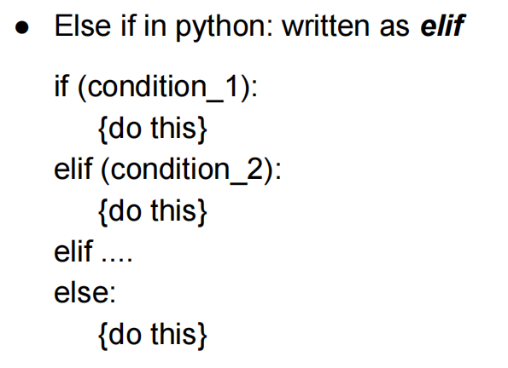
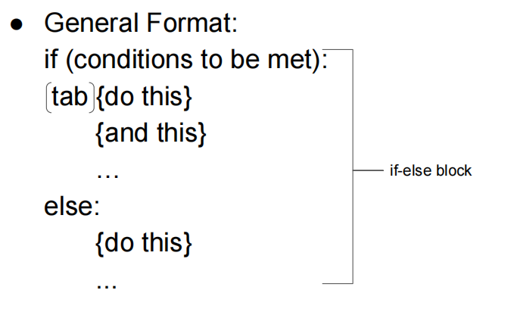
Conditional Statements

Slide 92
Conditional Statements
Example: check if a number is positive, negative or zero
num = 62
if (num<0):
print(“Number is negative”)
elif (num==0):
print(“Number is zero”)
else:
print(“Number is positive”)

Slide 93
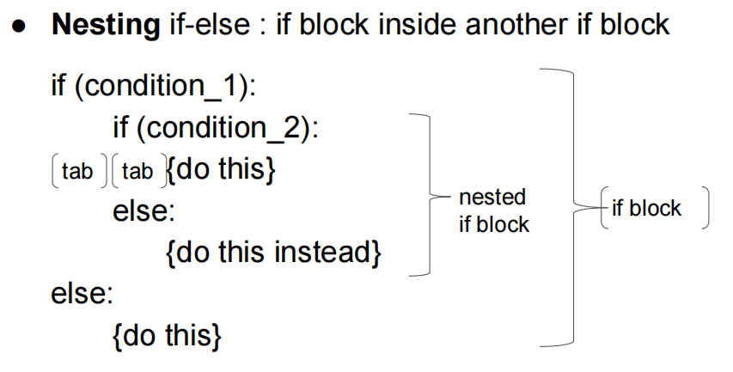
Complex Conditional Statements

Slide 94
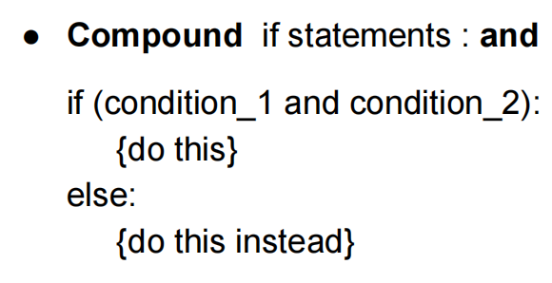

Complex Conditional Statements

Slide 95


While Loop

Slide 96

While Loop

Slide 97
While Loop
Example : sum of first 10 numbers
Sum=0
a=1
While (a<11):
sum=sum+a
a=a+1
Print(sum)

Slide 98
While Loop
Example : sum of first 10 numbers
num=1
sum=0
while (num <= 10):
sum = sum + num
num = num + 1
else :
print(sum)

Slide 99

for Loop
Sum of elements in a list
???
Lst=[1,2,3,5,7,9]
Sum=0
For x in Lst
sum=sum +x
Print(sum)

Slide 100
for Loop
Sum of elements in a list
a = [1,5,2,3,7]
s = 0
for i in a:
s += i
print s

Slide 101
for Loop
for Loop and 2D List
a = [ [1,2] , [3,6], [6,9] ]
for i in a:
print i
a = [ [1,2] , [3,6], [6,9] ]
for i,j in a:
print i,j
What is difference??
for Loop and Strings
s = “Hello”
for i in s:
print i
Output ???

Slide 102
for Loop
for Loop and 2D List
a = [ [1,2] , [3,6], [6,9] ]
for i in a:
print i
Output: [1, 2] [3, 6] [6, 9]
a = [ [1,2] , [3,6], [6,9] ]
for i,j in a:
print i,j
Output: 1 2 3 6 6 9
for Loop and Strings
s = “Hello”
for i in s:
print i
Output : Print every character in newline

Slide 103
list comprehension
Square each element of a list,
a = [1,2,3,4,5]
[i**2 for i in a]
Check if elements are even or odd,
a = [2,3,6,5,1,4,8]
[i%2==0 for i in a]
lst = ["even" if i % 2 == 0 else "odd" for i in a]
>> print range(10) What will be output??

Slide 104
Dictionaries
● Objects with key-value pairs
● Contains a list of items where each item is a pair, i.e (key,value)
● Represented as ‘{}’
● Eg : D = {‘a’:5, ‘b’:6, ‘c’:7}
● Accessing items : D[‘a’] # will print 5
● No variables

Slide 105
Dictionaries
● D = {‘a’:2, ‘b’:3, ‘c’:5 }
● D.keys() # will print [‘a’, ‘b’, ‘c’]
● D.values() # will print [2,3,5]
● D.items() # will print [(‘a’,2), (‘b’,3),(‘c’,5)]
● dict( [ (1,2), (3,5) ]) # will return {1:2, 3:5}
● Why do I need a dictionary ?
● Practice problem : Reverse a dictionary

Slide 106

Built-in Dictionary Functions & Methods

Slide 107

Dictionary Methods

Slide 108

UDF

Slide 109

UDF

Slide 110

Standard Functions

Slide 111
Maths for Machine Learning
Statistics
Probability
Metrics
Vectors
Linear Equation
Regression

Slide 112

Statistics

Slide 113

Important Terminology

Slide 114

Important Terminology

Slide 115

Types of Sampling

Slide 116

Probabilistic Sampling

Slide 117

Types of Statistics

Slide 118

Types of Statistics

Slide 119
Types of Statistics
Descriptive Statistics
In the descriptive Statistics, the Data is described in a summarized way. The summarization is done from the sample of the population using different parameters like Mean or standard deviation. Descriptive Statistics are a way of using charts, graphs, and summary measures to organize, represent, and explain a set of Data.
Data is typically arranged and displayed in tables or graphs summarizing details such as histograms, pie charts, bars or scatter plots.
Descriptive Statistics are just descriptive and thus do not require normalization beyond the Data collected.

Slide 120

Types of Statistics

Slide 121
Types of Statistics
Inferential Statistics
In the Inferential Statistics, we try to interpret the Meaning of descriptive Statistics. After the Data has been collected, analyzed, and summarised we use Inferential Statistics to describe the Meaning of the collected Data.
Inferential Statistics use the probability principle to assess whether trends contained in the research sample can be generalized to the larger population from which the sample originally comes.
Inferential Statistics are intended to test hypotheses and investigate relationships between variables and can be used to make population predictions.
Inferential Statistics are used to draw conclusions and inferences, i.e., to make valid generalizations from samples.

Slide 122
Why Statistics in ML?
Statistics is a core component of data analytics and machine learning. It helps you analyze and visualize data to find unseen patterns.
Descriptive statistical methods are used to transform raw observations into information that you can understand and share.
Inferential statistical methods are used to reason from small samples of data to whole domains.

Slide 123

Descriptive Statistics

Slide 124

Descriptive Statistics

Slide 125

Descriptive Statistics : Measure

Slide 126

2,4,4,6,8
Median (Middle value when sorted)
Steps:
Arrange in order → 2, 4, 4, 6, 8 (already sorted)
Middle value (3rd value, since there are 5 numbers) = 4
Mode (Most frequent value)
Frequency: 2 (once), 4 (twice), 6 (once), 8 (once)
The number 4 occurs most often.

Slide 127

Median formula

Slide 128


Descriptive Statistics : Measure

Slide 129


Descriptive Statistics : Measure

Slide 130


Descriptive Statistics : Measure

Slide 131

Measure of Spread

Slide 132

Measure of Spread

Slide 133

Measure of Spread

Slide 134

Measure of Spread

Slide 135
Range in Statistics
The range is a measure of dispersion (spread).
It shows how far the data values are spread out by looking at the difference between the largest and smallest value.
3, 7, 10, 15, 20
Formula:
Range = Maximum Value − Minimum Value
Range(17) =20 - 3

Slide 136
What is Interquartile Range (IQR)
The IQR measures the spread of the middle 50% of the data.
It reduces the effect of extreme values (outliers), unlike the range.
IQR=Q3​−Q1
Steps to Calculate IQR (Ungrouped Data):
Arrange data in ascending order.
Find Q1 (25% point) and Q3 (75% point).
Subtract: Q3−Q1​.

Slide 137

6, 7, 15, 36, 39, 40, 41, 42, 43, 47, 49
Number of observations n=11

Slide 138



Example

Slide 139

Example

Slide 140

Statistics using Python

Slide 141


Example:

Slide 142

Inferential Statistics

Slide 143
Definition of Inferential Statistics
Inferential statistics uses statistical techniques to extrapolate information from a smaller sample to make predictions and draw conclusions about a larger population.
It uses probability theory and statistical models to estimate population parameters and test population hypotheses based on sample data. The main goal of inferential statistics is to provide information about the whole population using sample data to make the conclusions drawn as accurate and reliable as possible.

Slide 144
There are two primary uses for inferential statistics:
Providing population estimations.
Testing theories to make conclusions about populations.
Researchers can generalize a population by utilizing inferential statistics and a representative sample. It requires logical reasoning to reach conclusions.
The following is a procedure of the method for arriving at the results:
The population that is to be investigated should be chosen as a sample. In this case, the nature and characteristics of the population must be reflected in the sample.
Inferential statistical techniques are used to analyze the sample’s behavior. These include the models used for regression analysis and hypothesis testing.
The first-step sample is used to draw conclusions. Assumptions or predictions about the entire population are used to draw inferences.

Slide 145
Types of Inferential Statistics
Inferential statistics are divided into two categories:
Hypothesis testing.
Regression analysis.
Researchers frequently employ these methods to generalize results to larger populations based on small samples. Let’s look at some of the methods available in inferential statistics.

Slide 146
01. Hypothesis testing
Testing hypotheses and drawing generalizations about the population from the sample data are examples of inferential statistics. Creating a null hypothesis and an alternative hypothesis, then performing a statistical test of significance are required.
A hypothesis test can have left-, right-, or two-tailed distributions. The test statistic’s value, the critical value, and the confidence intervals are used to conclude. Below are a few significant hypothesis tests that are employed in inferential statistics.

Slide 147
Z Test
When data has a normal distribution and a sample size of at least 30, the z test is applied to the data. When the population variance is known, it determines if the sample and population means are equal. The following setup can be used to test the right-tailed hypothesis:
Null Hypothesis: H₀: μ=μ₀
Alternate hypothesis: H₁: μ>μ₀
Test Statistic: Z Test = (x̄ – μ) / (σ / √n)
where,
x̄ = sample mean
μ = population mean
σ = standard deviation of the population
n = sample size
Decision Criteria: If the z statistic > z critical value, reject the null hypothesis.

Slide 148
T Test
When the sample size is less than 30, and the data has a student t distribution, a t test is utilized. The sample and population mean are compared when the population variance is unknown. The inferential statistics hypothesis test is as follows:
Null Hypothesis: H₀: μ=μ₀
Alternate Hypothesis: H₁: μ>μ₀
Test Statistic: t = x̄−μ / s√n
The representations x̄, μ, and n are the same as stated for the z-test. The letter “s” represents the standard deviation of the sample.
Decision Criteria: If the t statistic > t critical value, reject the null hypothesis.

Slide 149

Matrix

Slide 150


Matrix

Slide 151


Matrix Multiplication : Different Size

Slide 152

Example

Slide 153

Example

Slide 154

Matrix

Slide 155

Example:

Slide 156



Slide 157

Linear Algebra

Slide 158

Linear Equation

Slide 159

Scalar

Slide 160

Vector

Slide 161

Vector : Machine Learning
A feature is a numerical or symbolic property of an aspect of an object. A feature vector is a vector containing multiple elements about an object. Putting feature vectors for objects together can make up a feature space.
The features may represent, as a whole, one mere pixel or an entire image. The granularity depends on what someone is trying to learn or represent about the object. You could describe a 3-dimensional shape with a feature vector indicating its height, width, depth, etc.

Slide 162

Vector : Machine Learning

Slide 163

Vector

Slide 164

Vector : Operation

Slide 165


Vector : Operation

Slide 166

Vector : Operation

Slide 167

Vector & Matrices

Slide 168

Vector & Matrices

Slide 169

Vector as Matrix : Solve Linear Equation

Slide 170

Vector as Matrix :Solve Linear Equation

Slide 171

Vector as Matrix :Solve Linear Equation

Slide 172

Vector as Matrix :Solve Linear Equation

Slide 173

Vector as Matrix :Solve Linear Equation

Slide 174


Example:

Slide 175


Example:

Slide 176


Example:

Slide 177


Slide 178

What is Probability?

Slide 179


Probability : Use Cases

Slide 180

Probability : Use Cases

Slide 181

Probability Terminology

Slide 182

Probability Terminology

Slide 183


Probability Terminology

Slide 184

Probability Terminology

Slide 185

Probability : Example
What is the probability that adding outcomes of both the dices will be SIX??

Slide 186

Types of Probability

Slide 187

Types of Probability

Slide 188

Marginal Probability

Slide 189

Joint Probability

Slide 190

Example :
What is the joint probability of rolling the number five twice in a fair six-sided dice?

Slide 191

Example :
What is the joint probability of getting a head followed by a tail in a coin toss?

Slide 192

Example :
What is the joint probability of drawing a number ten card that is black?

Slide 193

Conditional Probability

Slide 194

Conditional Probability

Slide 195
Example:
In a group of 100 sports car buyers, 40 bought alarm systems, 30 purchased bucket seats, and 20 purchased an alarm system and bucket seats. If a car buyer chosen at random bought an alarm system, what is the probability they also bought bucket seats?

Slide 196

Example:
In a group of 100 sports car buyers, 40 bought alarm systems, 30 purchased bucket seats, and 20 purchased an alarm system and bucket seats. If a car buyer chosen at random bought an alarm system, what is the probability they also bought bucket seats?
P(B|A) = P(A∩B) / P(A) = 0.2 / 0.4 = 0.5.

Slide 197
Example:
Suppose you draw two cards from a deck and you win if you get a jack followed by an ace (without replacement). What is the probability of winning, given we know that you got a jack in the first turn?
Let event A be getting a jack in the first turn
Let event B be getting an ace in the second turn.

Slide 198

Example:

Slide 199
Example:
Suppose you have a jar containing 6 marbles – 3 black and 3 white. What is the probability of getting a black given the first one was black too.
P (A) = getting a black marble in the first turn
P (B) = getting a black marble in the second turn

Slide 200

Example:

Slide 201

Example:

Slide 202
Example:
Ans is: 0.024

Slide 203

Example:

Slide 204

Example:

Slide 205

Conditional Probability : Baye’s Theorem

Slide 206

Example:

Slide 207

Example:
What is the probability of drawing 2 King from a deck?

Slide 208
End of Unit I.....
Project Ideas
Automation + Intelligence
Application ORIENTED
Cyber Sec. & Digital Foren

Slide 209
AI project IDEAS..
Phishing Email Detection -Here we develop an AI system to study emails and regulate whether they are phishing attempts by using Natural Language Processing, Machine Learning (Naive Bayes, SVM), Python.
Intrusion Detection System – By using Machine Learning (Random Forest, Decision Trees), Packet Sniffing Tools, Python we build an intelligent intrusion detection system which can sense and flag anomalous actions on an network.
Malware Classification – For better identification and removal we organize malicious software into groups. The technologies applied are Machine Learning (Convolutional Neural Networks), Binary Analysis, Python.
Real-time Threat Intelligence – An AI-driven system will be developed to gather and analyse threat data in real-time using Big Data, Natural Language Processing, Python.
User Behaviour Analytics – To detect any abnormal behaviour that could suggest a security threat, we will create a system that learns the normal behaviour of the users. Machine Learning (K-means clustering), Python are the technologies used here.
Password Strength Checker –Our main objective here is to calculate the strength of passwords and foresee how easily they could be cracked by using AI by applying Natural Language Processing, Python.
Secure Multi-Factor Authentication – AI-based multi-factor authentication system is developed by our team using Machine Learning (Decision Trees), Biometrics, Python, to adjust the authentication steps based on the level of risk that is recognised.
Automated Vulnerability Assessment –Here we must create a system that uses AI to automatically evaluate susceptibilities in a given network or software. We make use of Machine Learning, Python, Scanning Tools.
Data Privacy Enhancement –To classify and screening sensitive data automatically by utilising an AI we use Natural Language Processing, Python.
Fake News Detection for Cyber Propaganda – To detect fake news articles that which is a part of cyber propaganda attacks our team builds an AI by using latest technologies and tools such as Natural Language Processing (NLP), Machine Learning algorithms like Random Forest or Gradient Boosting, Python.

Slide 210
Project Ideas
Generating Textures and Patterns
Healthcare: predict stroke risk using a prediction model and provide personalized warning message
Handwriting Matching
Labeling of Audio File
Online Exam Invigilation
Game related to cyber Security
Accident Prediction
Chatboat for Univ.
AI/Ml for Dark web
Anomaly Detection
Phishing detection –WhatsApp
Behaviour Modelling System
Fake news detection

Slide 211
Reference links
https://www.cisco.com/c/en/us/solutions/artificial-intelligence/artificial-intelligence-machine-learning-in-networking.html#~technology
https://www.sciencedirect.com/science/article/pii/S2405959522000741
https://trepo.tuni.fi/bitstream/handle/10024/143107/FrederickBenedict.pdf?sequence=2&isAllowed=y
https://www.nsnam.org/wp-content/uploads/2021/tutorials/ns3-ai-tutorial-June-2021.pdf
https://www.leewayhertz.com/ai-in-networking/#How-is-AI-in-networking-different-from-traditional-networking

Slide 212
Other Topics
Research on Network Information Security Model Based on Computer Artificial Intelligence Technology
Explainable Artificial Intelligence in Cybersecurity: A Brief Review
Artificial Intelligence (AI) and Machine Learning (ML)-based Information Security in Electric Vehicles: A Review
The Effect of Artificial Intelligence on Cybersecurity
Cybersecurity as a Tic-Tac-Toe Game Using Autonomous Forwards (Attacking) And Backwards (Defending) Penetration Testing in a Cyber Adversarial Artificial Intelligence System
Artificial Intelligence Cyber Security Strategy
Artificial Intelligence Security Competition (AISC)
Artificial Intelligence-Based Cyber Security Applications
Physical Layer Security in the Age of Artificial Intelligence and Edge Computing
Artificial Intelligence Autonomous Unmanned Aerial Vehicle (UAV) System for Remote Sensing in Security Surveillance
Using Artificial Intelligence to Integrate Machine Learning, Fuzzy Logic, and The IOT as A Cybersecurity System

Slide 213
AI in Blockchain Towards Realizing Cyber Security
Nano-Artifact Metrics Chip Mounting Technology for Edge AI Device Security
TRUST XAI: Model-Agnostic Explanations for AI With a Case Study on IIoT Security
Toward Integrated Virtual Emotion System with AI Applicability for Secure CPS-Enabled Smart Cities: AI-Based Research Challenges and Security Issues
Hardware-enabled AI for Embedded Security: A New Paradigm
Analysis of network security and privacy security based on AI in IOT environment
A Comprehensive Study on Review of AI Techniques to Provide Security in the Digital World
Cyber Security Risk Assessment on Industry 4.0 using ICS testbed with AI and Cloud
AI-based Network Security Enhancement for 5G Industrial Internet of Things Environments

